Slide 1
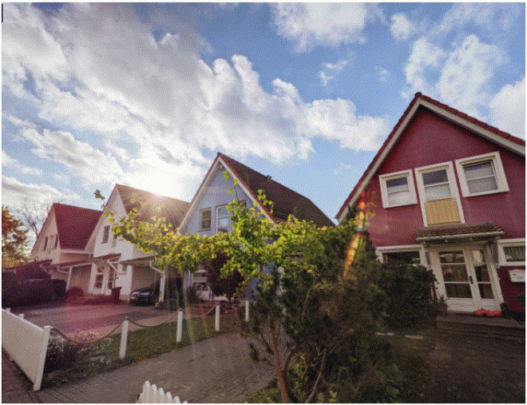
HOUSING DATA SET
*
Name : V .Ragul
Course: Data science & Data analyst
Topic: Housing data set
Date: 23-7-2024

Slide 2
Introduction
- Housing data set -A housing dataset typically contains information about various aspects of housing, including details about individual properties, their locations, and related economic and demographic data. These datasets are used for a variety of purposes, such as real estate analysis, market research, urban planning, and academic research.
Property Details:_ Price,Size, number of bathroom. Number of bedroom
* data cleaning- Data cleaning, also known as data cleansing or data scrubbing, is the process of identifying and correcting (or removing) errors and inconsistencies in data to improve its quality. This process is crucial because data often comes from various sources and may contain duplicates, inaccuracies, incomplete entries, or irrelevant information.
Data Visualization - Data visualization is the graphical representation of information and data. By using visual elements like charts, graphs, and maps, data visualization tools provide an accessible way to see and understand trends, outliers, and patterns in data.

Slide 3
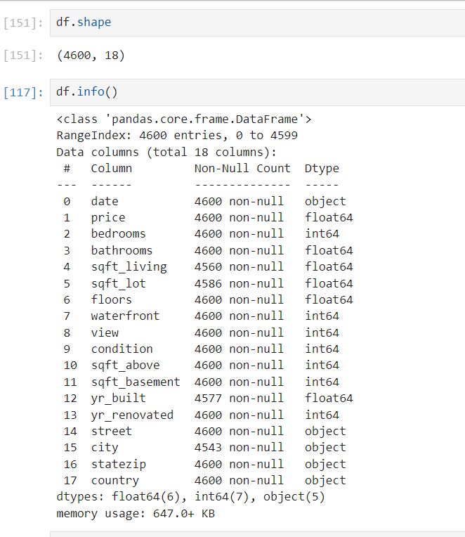
Data Understanding
df .shape
df.info()
*df.shape & df.info are used to understand the
Structure and content of a pandas data frame
df.shape
df.info()

Slide 4
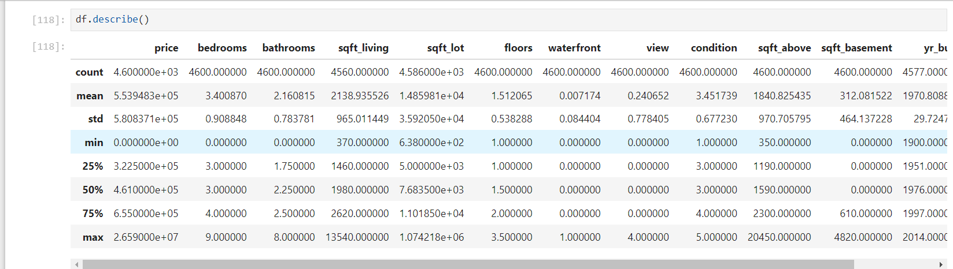
df.describe ()
* df.describe we can quickly get a distribution of values in the data and identify potential
*The provide a summary of the price column you can see that it mean, count,std,min,many more etc

Slide 5
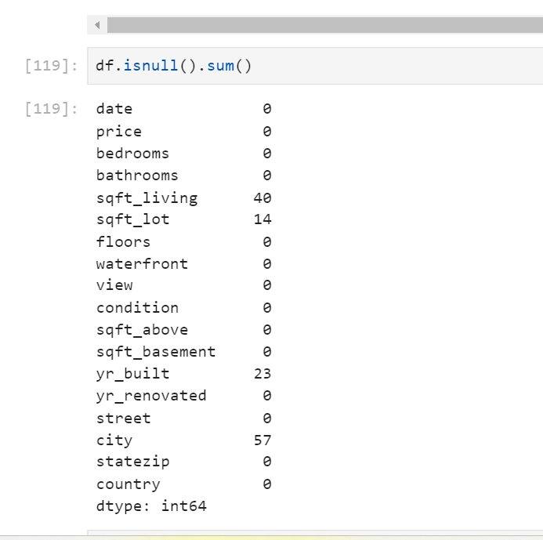
df.insull().sum()
*df.Insnull().sum() it showing the missing
The value of the column
It shows the total Number of Null
Values in each column To identify
The missing data value
Sum().calculate the sum of the
Effectively counting the number of
Missing values in the each column

Slide 6
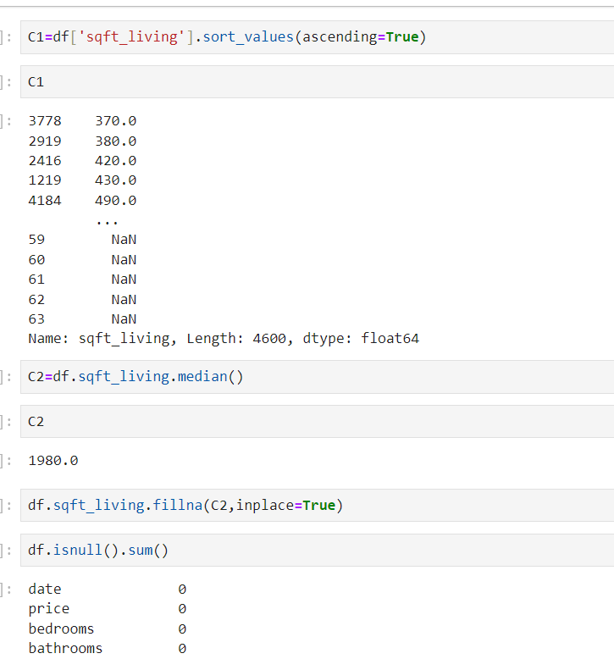
Missing Values Handling
* Missing value handling refers to the proesss of managing the processing data with missing or null value

Slide 7
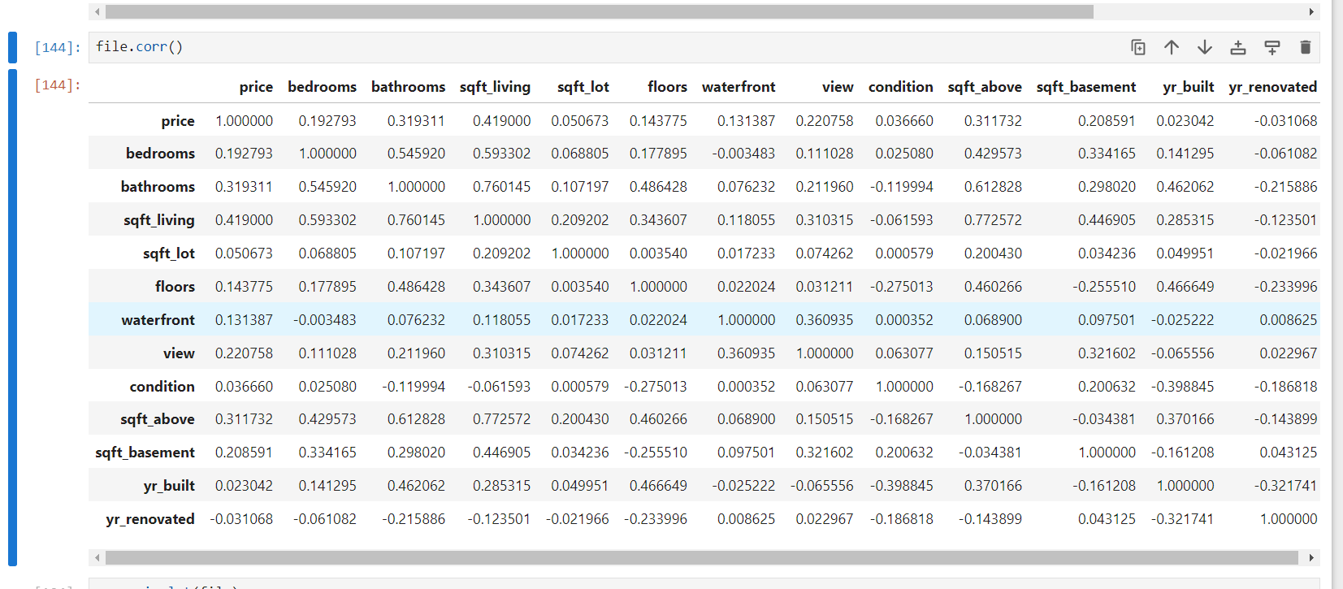
File correlation
* File correlation involves analyzing the relationships between different variables within a dataset and visualizing these relationships using a heatmap. This is particularly useful for identifying patterns, trends, and correlations in large datasets.

Slide 8
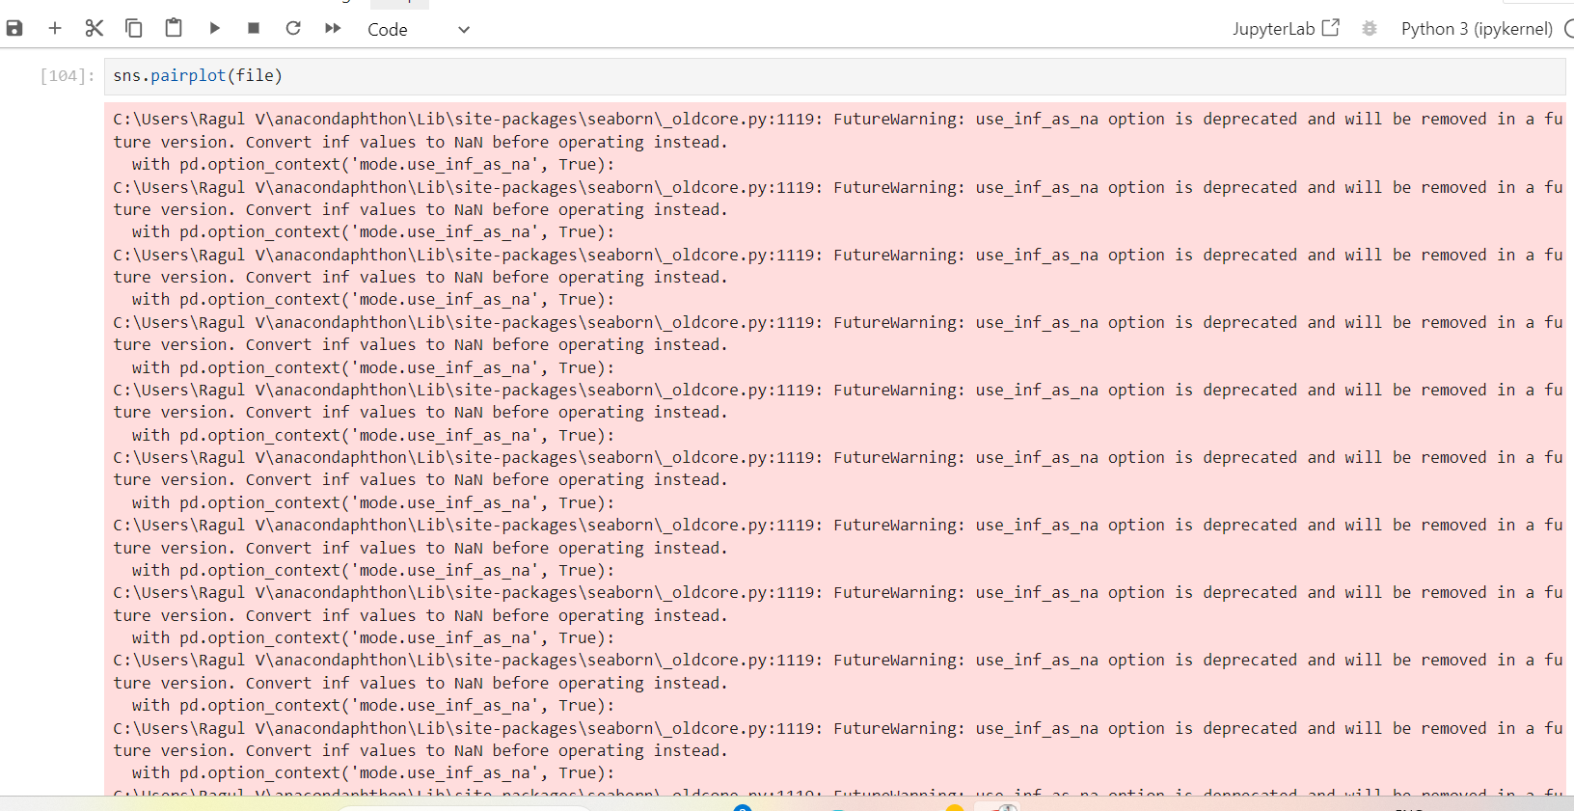
sns.pairplot
*sns.pairplot is is a powerful function for visualizing pairwise relationships in a dataset. It creates a grid of scatter plots for each pair of variables in the dataset, along with histograms or kernel density plots for the individual distributions of each variable.

Slide 9
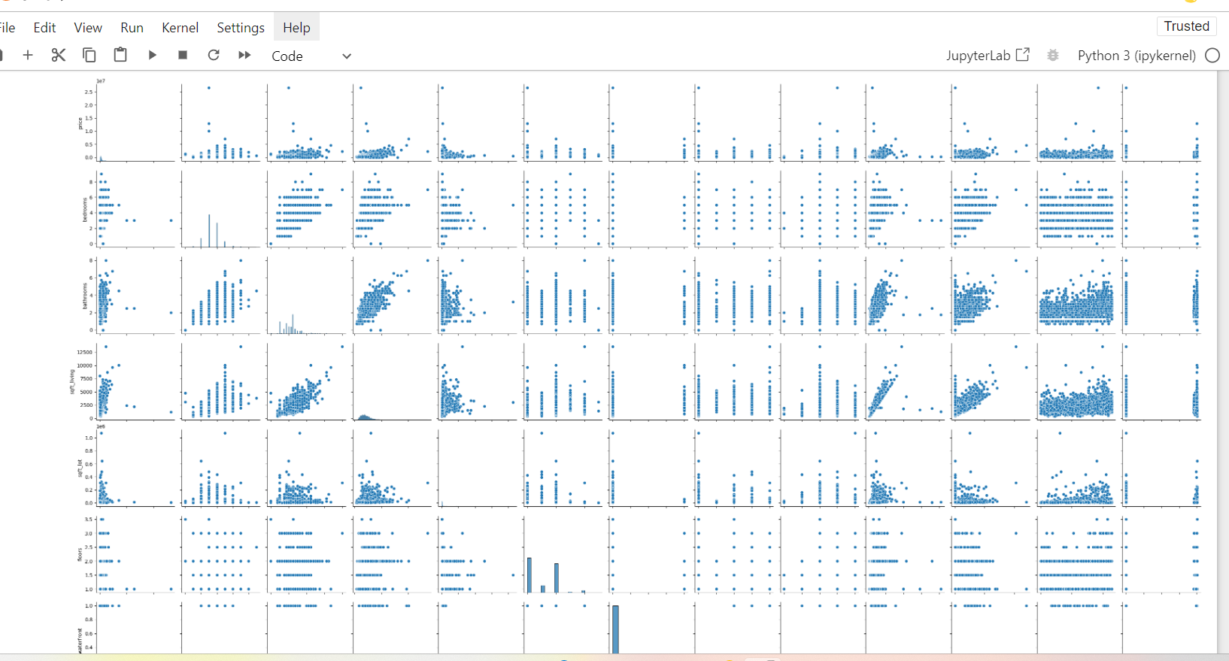
Scatter plot
* A scatter plot is a type of data visualization that displays values for typically two variables for a set of data. The values of one variable are displayed along the x-axis and the values of the other variable are displayed along the y-axis, resulting in points that reveal any correlation or pattern.

Slide 10
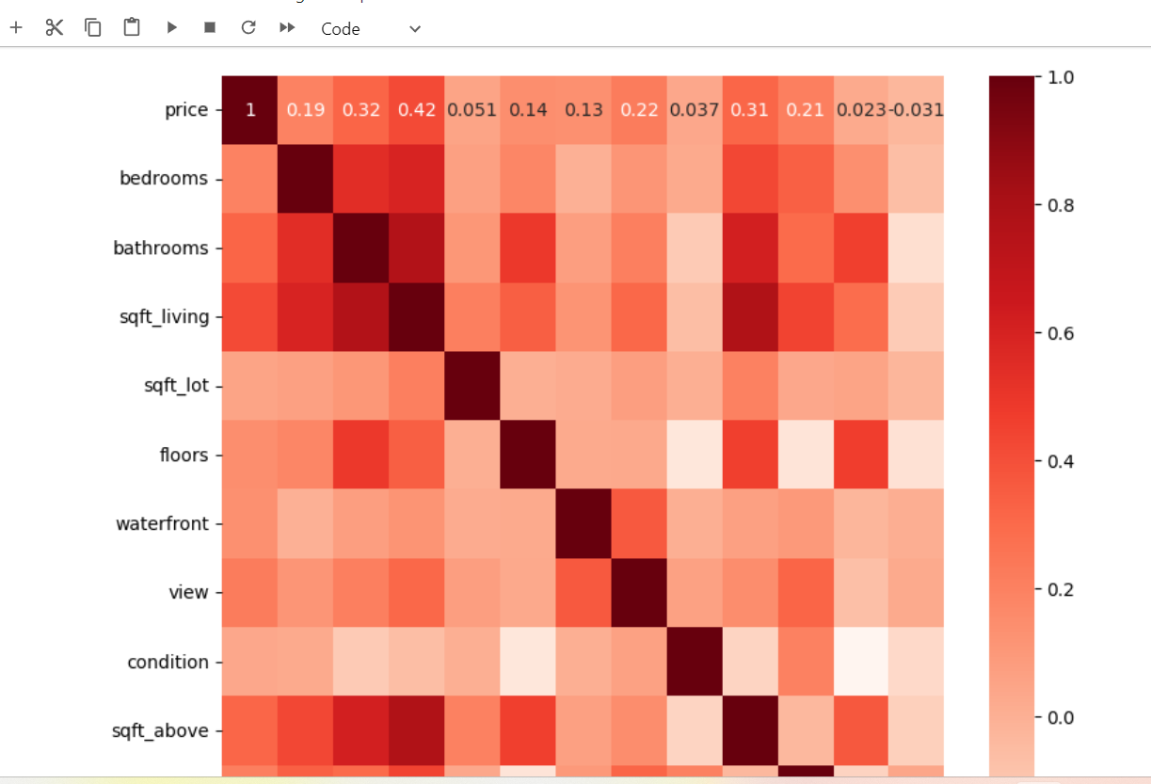
Heatmap
A heatmap is a graphical representation of data where individual values are represented as colors. It's a great way to visualize data patterns and trends. There are several types of heatmaps, including:

Slide 11
Thank you

